Slide 1
Dependency Grammars and Parsing - Introduction
Pawan Goyal
CSE, IIT Kharagpur
Week 6, Lecture 1
Dependency Grammars and Parsing - Introduction
Week 6, Lecture 1
1 / 11

Slide 2
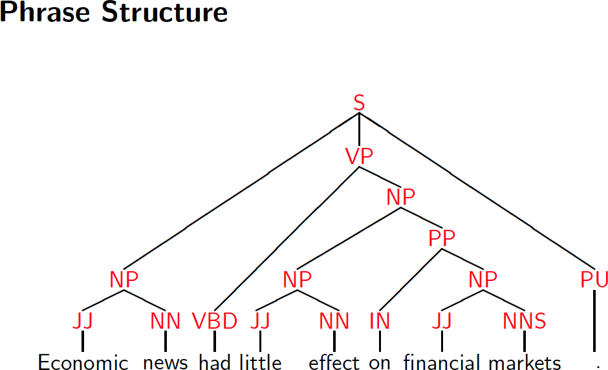
Phrase Structure Representation
Dependency Grammars and Parsing - Introduction
Week 6, Lecture 1
2 / 11

Slide 3
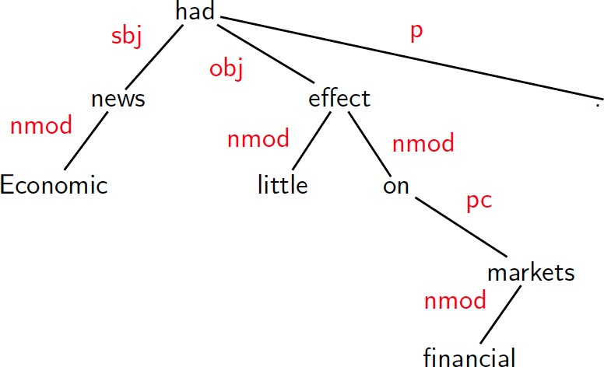
Dependency Structure Representation
Dependency Grammars and Parsing - Introduction
Week 6, Lecture 1
3 / 11

Slide 4
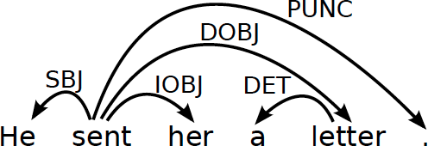
Dependency Structure
Connects the words in a sentence by putting arrows between the words.
Arrows show relations between the words and are typed by some grammatical relations.
Arrows connect a head (governor, superior, regent) with a dependent (modifier, inferior, subordinate).
Usually dependencies form a tree.
Dependency Grammars and Parsing - Introduction
Week 6, Lecture 1
4 / 11

Slide 5
Criteria for Heads and Dependents
Criteria for a syntactic relation between a head H and a dependent D in a construction C
H determines the syntactic category of C; H can replace C.
D specifies H.
H is obligatory; D may be optional.
H selects D and determines whether D is obligatory.
The form of D depends on H (agreement or government). The linear position of D is specified with reference to H.
Dependency Grammars and Parsing - Introduction
Week 6, Lecture 1
5 / 11

Slide 6
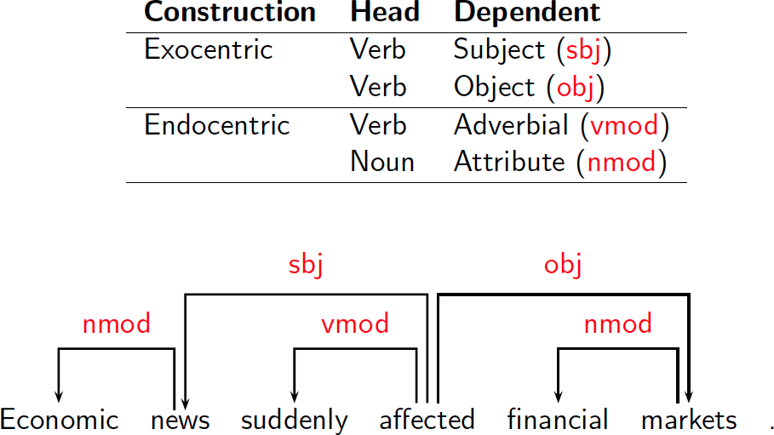
Some Clear Cases
Dependency Grammars and Parsing - Introduction
Week 6, Lecture 1
6 / 11

Slide 7
Comparison
Phrase structures explicitly represent
Phrases (nonterminal nodes)
Structural categories (nonterminal labels)
Dependency structures explicitly represent Head-dependent relations (directed arcs) Functional categories (arc labels)
Dependency Grammars and Parsing - Introduction
Week 6, Lecture 1
7 / 11

Slide 8
Dependency Graphs
A dependency structure can be defined as a directed graph G, consisting of
a set V of nodes,
a set A of arcs (edges),
Labeled graphs:
Nodes in V are labeled with word forms (and annotation).
Arcs in A are labeled with dependency types.
Notational convention:
Arc (w_{i}, d, w_{j}) links head w_{i} to dependent w_{j} with label d
d
w_{i} −→ w_{j} ⇔ (w_{i}, d, w_{j}) ∈ A
i → j ≡ (i, j) ∈ A
i→∗j ≡ i = j ∨ ∃k : i → k, k→∗j
Dependency Grammars and Parsing - Introduction
Week 6, Lecture 1
8 / 11

Slide 9
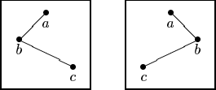
Formal conditions on Dependency Graphs
G is connected:
For every node i there is a node j such that i → j or j → i.
G is acyclic:
if i → j then not j→∗i.
G obeys the single head constraint:
if i → j then not k → j, for any k ≠ i.
G is projective:
if i → j then j→∗k, for any k such that both j and k lie on the same side of i.
Dependency Grammars and Parsing - Introduction
Week 6, Lecture 1
9 / 11

Slide 10
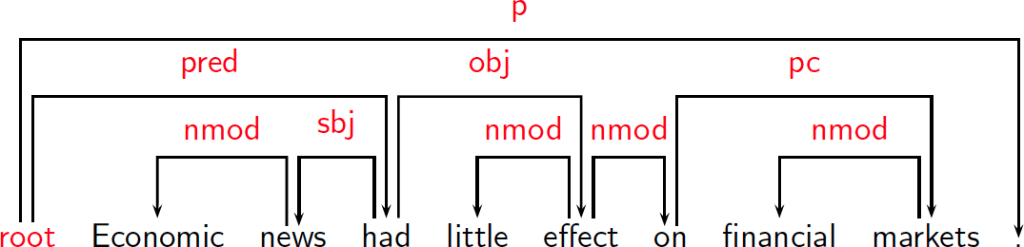
Formal Conditions: Basic Intuitions
Connectedness, Acyclicity and Single-Head Connectedness: Syntactic structure is complete. Acyclicity: Syntactic structure is hierarchical.
Single-Head: Every word has at most one syntactic head.
Projectivity: No crossing of dependencies.
Dependency Grammars and Parsing - Introduction
Week 6, Lecture 1

Slide 11
Dependency Parsing
Dependency Parsing
Input: Sentence x = w₁,..., w_{n}
Output: Dependency graph G
Parsing Methods
Deterministic Parsing
Maximum Spanning Tree Based Constraint Propagation Based
Dependency Grammars and Parsing - Introduction
Week 6, Lecture 1

Slide 12
Transition Based Parsing: Formulation
Pawan Goyal
CSE, IIT Kharagpur
Week 6, Lecture 2
Transition Based Parsing: Formulation
Week 6, Lecture 2
1 / 15

Slide 13
Deterministic Parsing
Basic idea
Derive a single syntactic representation (dependency graph) through a deterministic sequence of elementary parsing actions
Configurations
A parser configuration is a triple c = (S, B, A), where S : a stack [. . . , w_{i}]_{S} of partially processed words, B : a buffer [w_{j}, . . .]_{B} of remaining input words,
A : a set of labeled arcs (w_{i}, d, w_{j}).
Transition Based Parsing: Formulation
Week 6, Lecture 2
2 / 15

Slide 14
Transition System
A transition system for dependency parsing is a quadruple S = (C, T, c_{s}, C_{t}), where
C is a set of configurations,
T is a set of transitions, such that t : C → C, c_{s} is an initialization function
C_{t} ⊆ C is a set of terminal configurations.
A transition sequence for a sentence x is a set of configurations
C_{0,m} = (c_{o}, c₁, . . . , c_{m}) such that
c_{o} = c_{s}(x), c_{m} ∈ C_{t}, c_{i} = t(c_{i−1}) for some t ∈ T
Initialization: ([]_{S}, [w₁,..., w_{n}]_{B},{})
Termination: (S, []_{B}, A)
Transition Based Parsing: Formulation
Week 6, Lecture 2
3 / 15

Slide 15
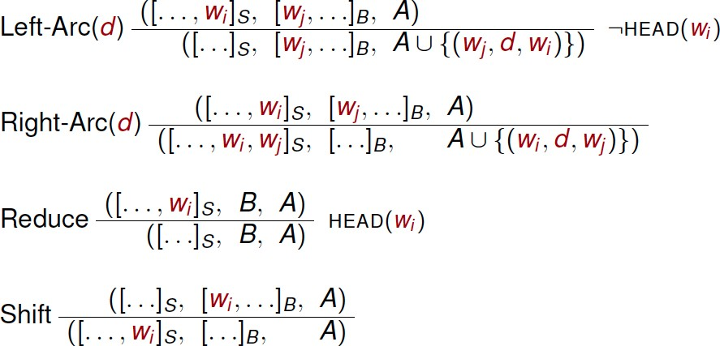
Transitions for Arc-Eager Parsing
Transition Based Parsing: Formulation
Week 6, Lecture 2

Slide 16
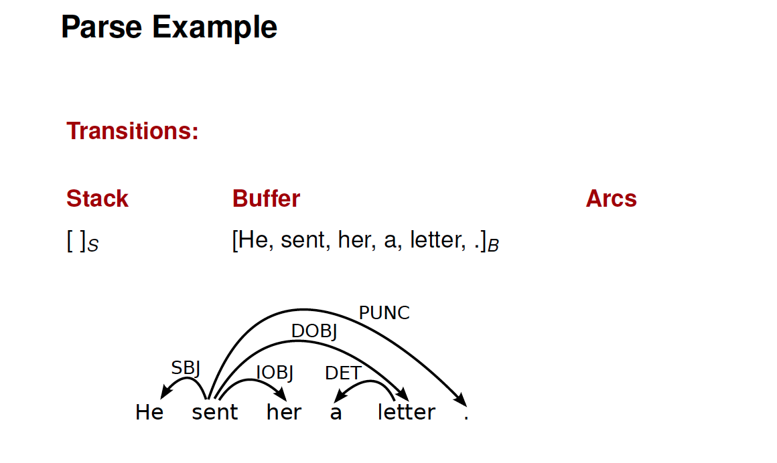
Example
Transition Based Parsing: Formulation
Week 6, Lecture 2

Slide 17
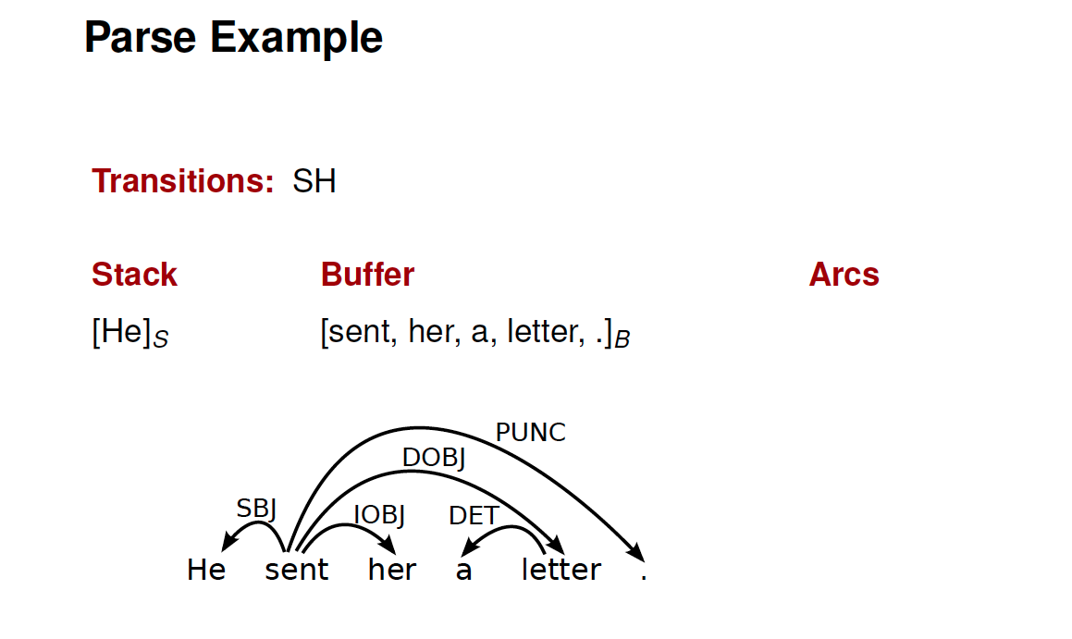
Example
Transition Based Parsing: Formulation
Week 6, Lecture 2

Slide 18
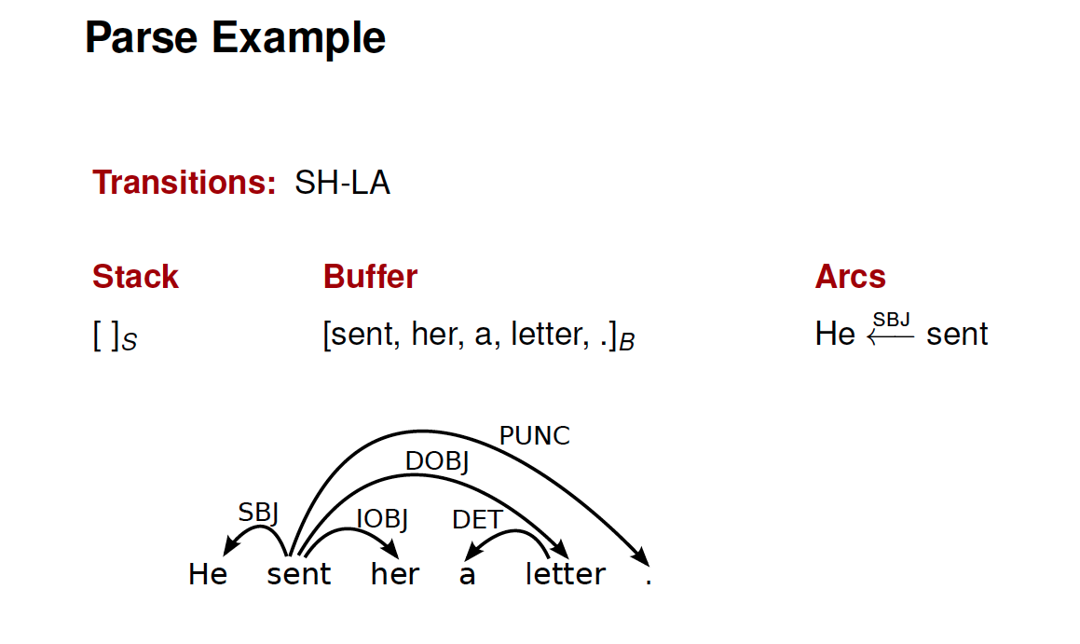
Example
Transition Based Parsing: Formulation
Week 6, Lecture 2

Slide 19
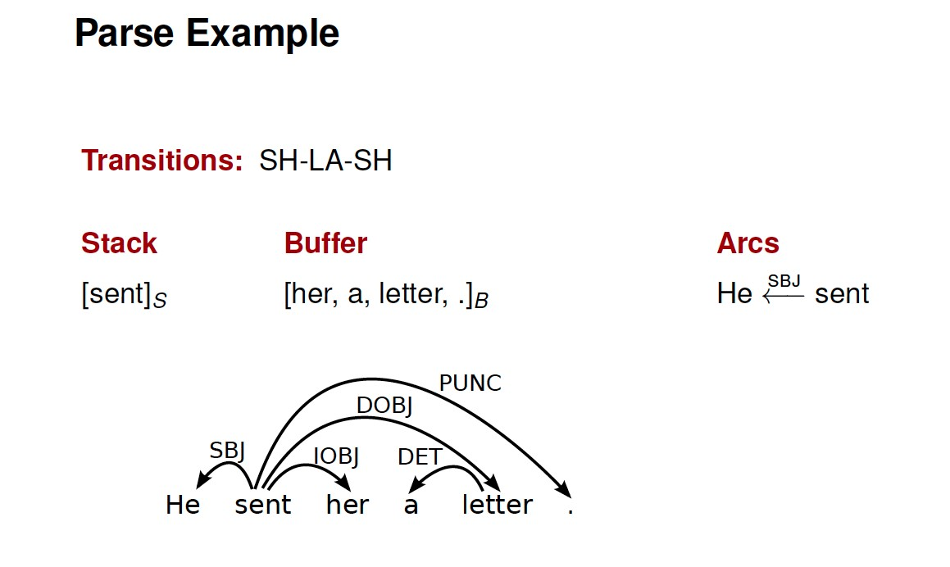
Example
Transition Based Parsing: Formulation
Week 6, Lecture 2

Slide 20
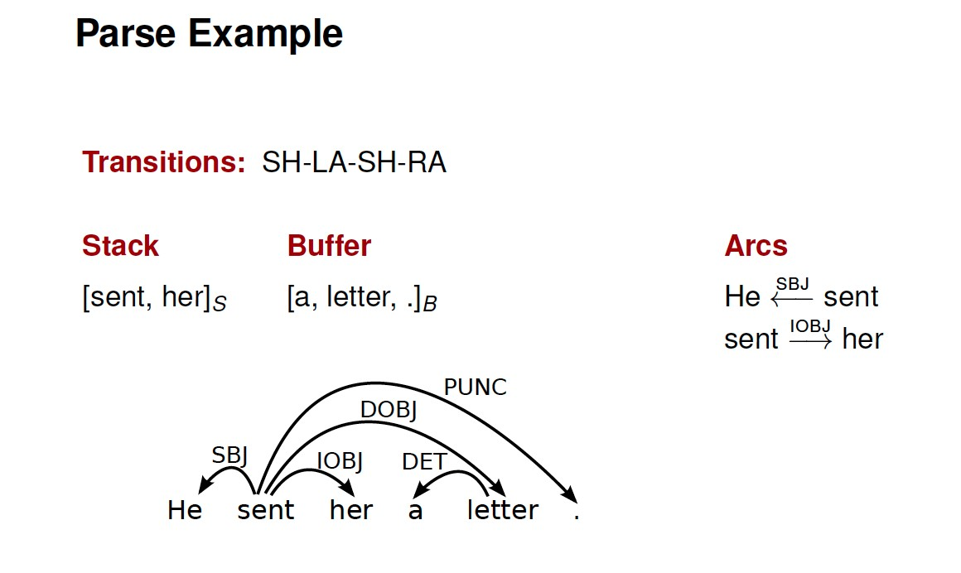
Example
Transition Based Parsing: Formulation
Week 6, Lecture 2

Slide 21
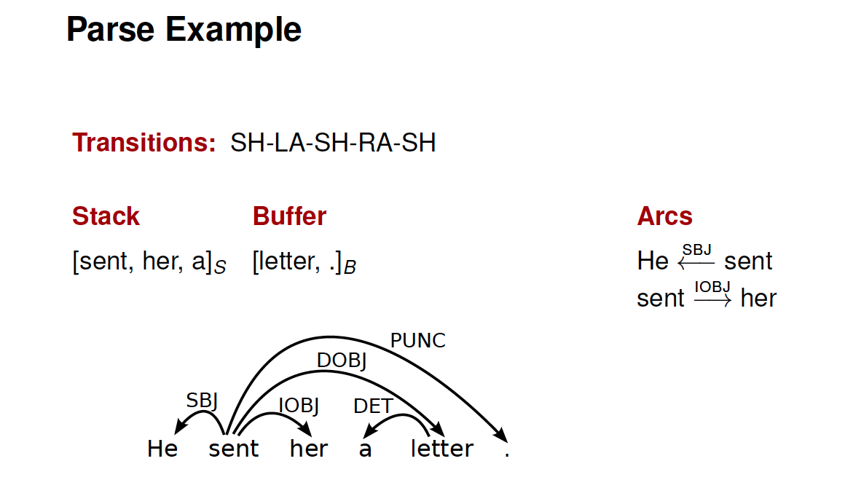
Example
Transition Based Parsing: Formulation
Week 6, Lecture 2

Slide 22
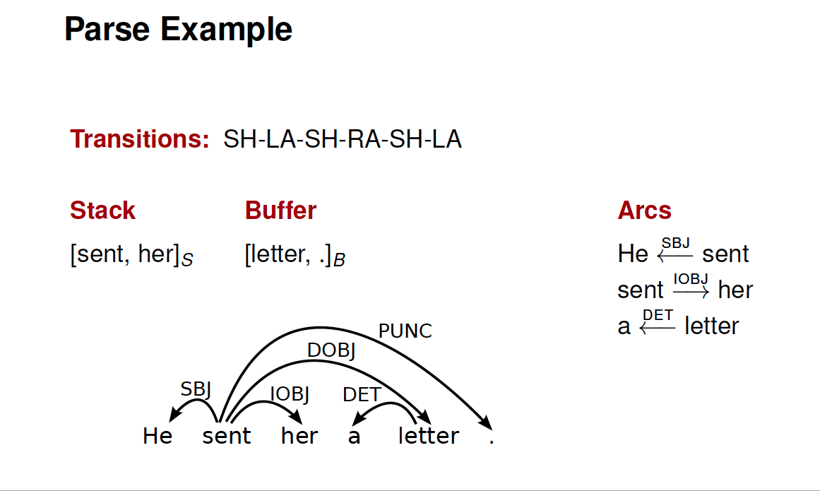
Example
Transition Based Parsing: Formulation
Week 6, Lecture 2

Slide 23
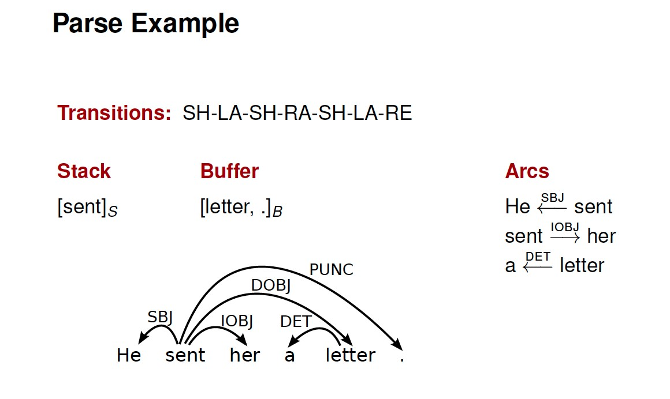
Example
Transition Based Parsing: Formulation
Week 6, Lecture 2

Slide 24
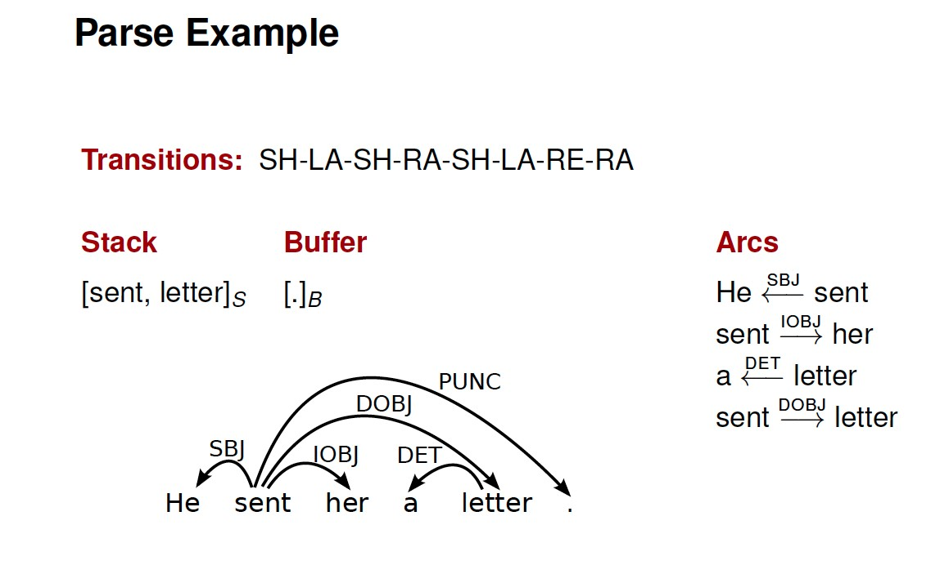
Example
Transition Based Parsing: Formulation
Week 6, Lecture 2

Slide 25
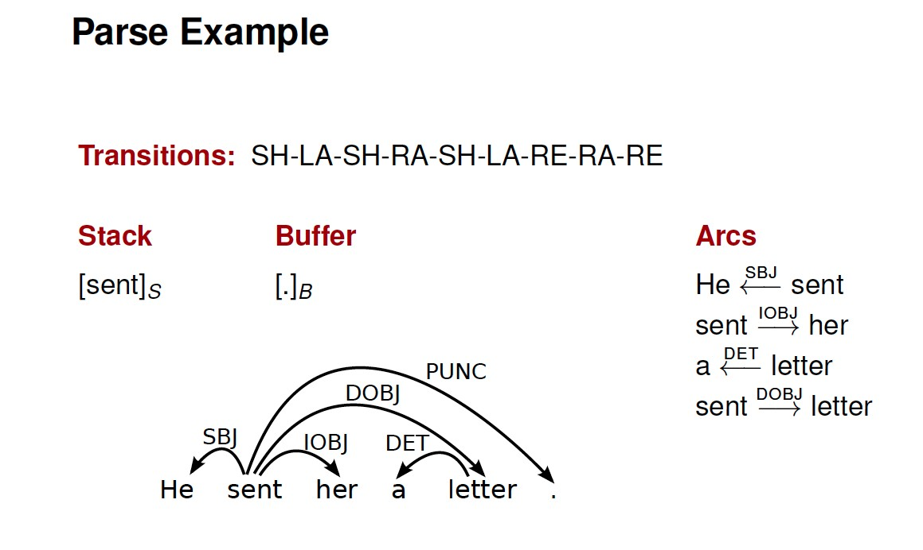
Example
Transition Based Parsing: Formulation
Week 6, Lecture 2

Slide 26
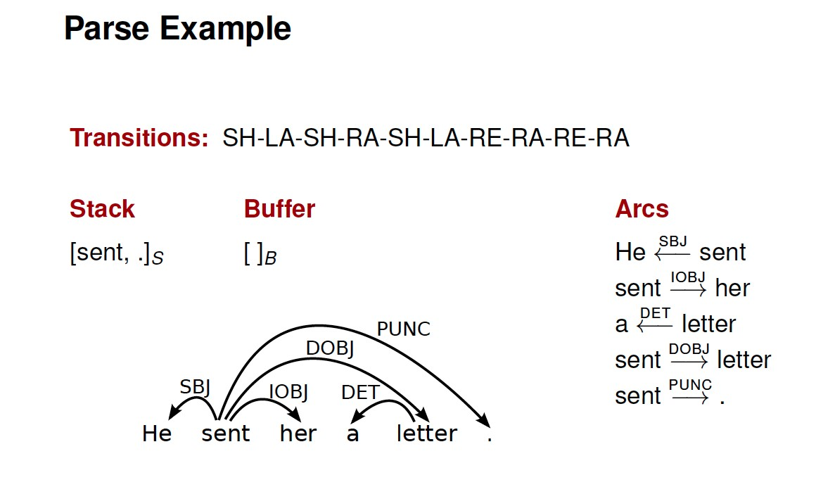
Example
Transition Based Parsing: Formulation
Week 6, Lecture 2

Slide 27
Transition Based Parsing: Learning
Pawan Goyal
CSE, IIT Kharagpur
Week 6, Lecture 3
Transition Based Parsing: Learning
Week 6, Lecture 3
1 / 8

Slide 28
Classifier-Based Parsing
Data-driven deterministic parsing:
Deterministic parsing requires an oracle.
An oracle can be approximated by a classifier. A classifier can be trained using treebank data.
Learning Problem
Approximate a function from configurations, represented by feature vectors to transitions, given a training set of gold standard transition sequences.
Three issues
How to represent configurations by feature vectors?
How to derive training data from treebanks? How to learn classifiers?
Transition Based Parsing: Learning
Week 6, Lecture 3
2 / 8

Slide 29
Feature Models
A feature representation f (c) of a configuration c is a vector of simple features
f_{i}(c).
Typical Features
Nodes:
Target nodes (top of S, head of B)
Linear context (neighbors in S and B)
Structural context (parents, children, siblings in G)
Attributes:
Word form (and lemma)
Part-of-speech (and morpho-syntactic features)
Dependency type (if labeled)
Distance (between target tokens)
Transition Based Parsing: Learning
Week 6, Lecture 3
3 / 8

Slide 30
Deterministic Parsing
To guide the parser, a linear classifier can be used:
t∗ = argmax w.f (c, t)
t
Weight vector w learned from treebank data.
Using classifier at run-time
PARSE(w₁, . . . , w_{n})
1 c ← ([]_{S}, [w₁,..., w_{n}]_{B},{})
while B_{c} ≠ []
t∗ ← argmax_{t} w.f (c, t)
4 c ← t∗(c)
5 return T = ({w₁,..., w_{n}}, A_{c})
Transition Based Parsing: Learning
Week 6, Lecture 3
4 / 8

Slide 31
Training data
Training instances have the form (f (c), t), where
f (c) is a feature representation of a configuration c,
t is the correct transition out of c (i.e., o(c) = t).
Given a dependency treebank, we can sample the oracle function o as follows:
For each sentence x with gold standard dependency graph G_{x}, construct a transition sequence C_{0,m} = (c₀, c₁, . . . , c_{m}) such that
c₀ = c_{s}(x), G_{cm} = G_{x}
For each configuration c_{i}(i < m), we construct a training instance (f (c_{i}), t_{i}), where t_{i}(c_{i}) = c_{i+1}.
Transition Based Parsing: Learning
Week 6, Lecture 3
5 / 8

Slide 32
Standard Oracle for Arc-Eager Parsing
o(c, T) =
Left-Arc if top(S_{c}) ← first(B_{c}) in T
Right-Arc if top(S_{c}) → first(B_{c}) in T Reduce if ∃w < top(S_{c}) : w ↔ first(B_{c}) in T Shift otherwise
Transition Based Parsing: Learning
Week 6, Lecture 3
6 / 8

Slide 33
Online Learning with an Oracle
LEARN({T₁,..., T_{N} })
1 w ← 0.0
for i in 1..K
for j in 1..N
4 c ← ([]_{S}, [w₁,..., w_{nj} ]_{B}, {})
5
6
7
8
9
10
11 return w
while B_{c} ≠ []
t∗ ← argmax_{t} w.f (c, t)
t_{o} ← o(c, T_{i})
if t∗ ≠ t_{o}
w ← w + f (c, t_{o}) − f (c, t∗)
c ← t_{o}(c)
Oracle o(c, T_{i}) returns the optimal transition of c and T_{i}
Transition Based Parsing: Learning
Week 6, Lecture 3
7 / 8

Slide 34
Example
Consider the sentence, ‘John saw Mary’.
Draw a dependency graph for this sentence.
Assume that you are learning a classifier for the data-driven deterministic parsing and the above sentence is a gold-standard parse in your training data. You are also given that John and Mary are ‘Nouns’, while the POS tag of saw is ‘Verb’. Assume that your features correspond to the following conditions:
The stack is empty
Top of stack is Noun and Top of buffer is Verb
Top of stack is Verb and Top of buffer is Noun
Initialize the weights of all your features to 5.0, except that in all of the above cases, you give a weight of 5.5 to Left-Arc. Define your feature vector and the initial weight vector.
Use this gold standard parse during online learning and report the weights after completing one full iteration of Arc-Eager parsing over this sentence.
Transition Based Parsing: Learning
Week 6, Lecture 3
8 / 8

Slide 35
MST-based Dependency Parsing
Pawan Goyal
CSE, IIT Kharagpur
Week 6, Lecture 4
MST-based Dependency Parsing
Week 6, Lecture 4
1 / 16

Slide 36
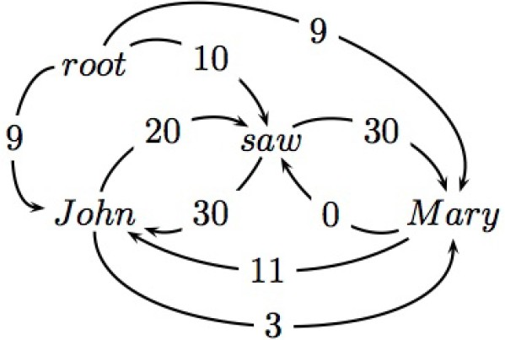
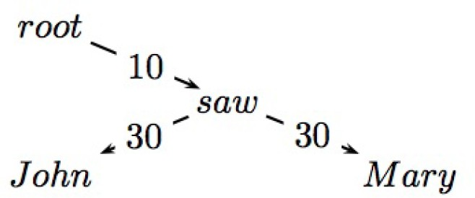
Maximum Spanning Tree Based
Basic Idea
Starting from all possible connections, find the maximum spanning tree.
MST-based Dependency Parsing
Week 6, Lecture 4
2 / 16

Slide 37
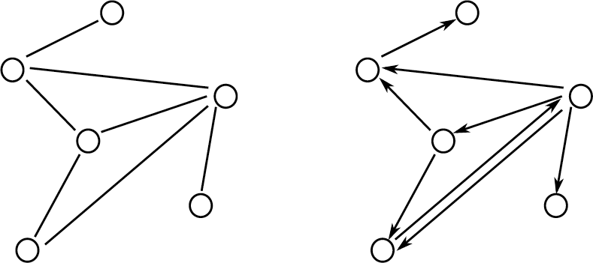
Some Graph Theory Reminders
A graph G = (V, A) is a set of vertices V and arcs (i, j) ∈ A where i, j ∈ V. Undirected graphs: (i, j) ∈ A ⇔ (j, i) ∈ A
Directed graphs (digraphs) : (i, j) ∈ A a (j, i) ∈ A
MST-based Dependency Parsing
Week 6, Lecture 4
3 / 16

Slide 38
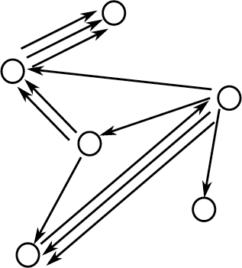
Multi-Digraphs
A multi-digraph is a digraph where multiple arcs between vertices are possible
(i, j, k) ∈ A represents the k^{th} arc from vertex i to vertex j.
MST-based Dependency Parsing
Week 6, Lecture 4
4 / 16

Slide 39
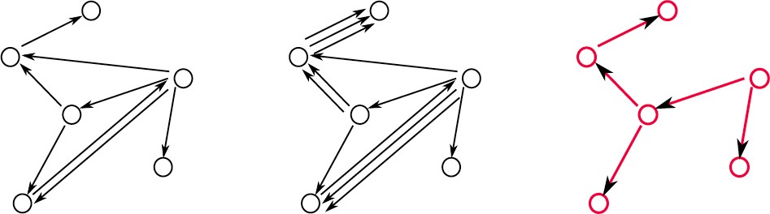
Directed Spanning Trees
A directed spanning tree of a (multi-)digraph G = (V, A) is a subgraph
G^{j} = (V^{j}, A^{j}) such that:
V^{j} = V
A^{j} ⊆ A, and |A^{j}| = |V^{j}| − 1
G^{j} is a tree (acyclic)
A spanning tree of the following (multi-)digraphs
MST-based Dependency Parsing
Week 6, Lecture 4
5 / 16

Slide 40
Weighted Directed Spanning Trees
Assume we have a weight function for each arc in a multi-digraph
G = (V, A).
Define w_{ij}^{k} ≥ 0 to be the weight of (i, j, k) ∈ A for a multi-digraph Define the weight of directed spanning tree G^{j} of graph G as
X
w(G^{j}) =
wij^{k}
(i,j,k)∈G^{j}
MST-based Dependency Parsing
Week 6, Lecture 4
6 / 16

Slide 41
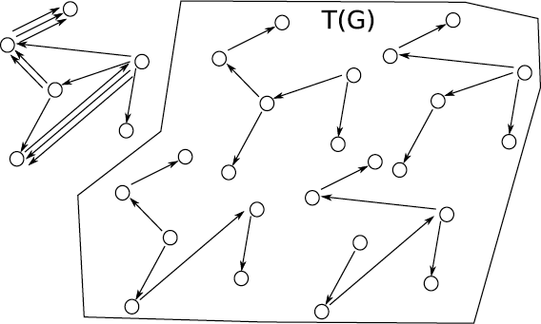
Maximum Spanning Trees (MST)
Let T(G) be the set of all spanning trees for graph G
The MST problem
Find the spanning tree G^{j} of the graph G that has the highest weight
X
G^{j} = argmax w(G^{j}) = argmax
wij^{k}
G^{j}∈T(G)
^{Gj∈T(G)} (i,j,k)∈G^{j}
MST-based Dependency Parsing
Week 6, Lecture 4
7 / 16

Slide 42
Finding MST
Directed Graph
For each sentence x, define the directed graph G_{x} = (V_{x}, E_{x}) given by
V_{x} = {x₀ = root, x₁, . . . , x_{n}}
E_{x} = {(i, j) : i ≠ j, (i, j) ∈ [0 : n] × [1 : n]}
G_{x} is a graph with
the sentence words and the dummy root symbol as vertices and a directed edge between every pair of distinct words and
a directed edge from the root symbol to every word
MST-based Dependency Parsing
Week 6, Lecture 4
8 / 16

Slide 43
Chu-Liu-Edmonds Algorithm
Chu-Liu-Edmonds Algorithm
Each vertex in the graph greedily selects the incoming edge with the highest weight.
If a tree results, it must be a maximum spanning tree. If not, there must be a cycle.
Identify the cycle and contract it into a single vertex.
Recalculate edge weights going into and out of the cycle.
MST-based Dependency Parsing
Week 6, Lecture 4

Slide 44
Chu-Liu-Edmonds Algorithm
x = John saw Mary
Build the directed graph
MST-based Dependency Parsing
Week 6, Lecture 4

Slide 45
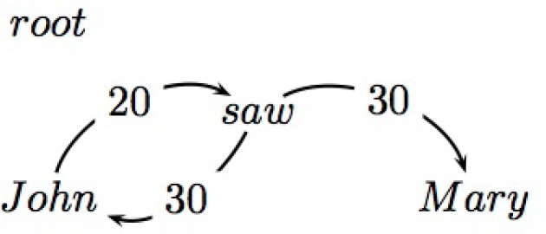
Chu-Liu-Edmonds Algorithm
Find the highest scoring incoming arc for each vertex
If this is a tree, then we have found MST.
MST-based Dependency Parsing
Week 6, Lecture 4

Slide 46
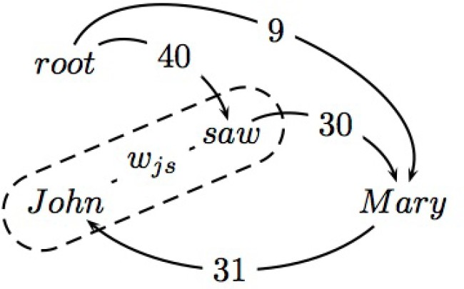
Chu-Liu-Edmonds Algorithm
If not a tree, identify cycle and contract Recalculate arc weights into and out-of cycle
MST-based Dependency Parsing
Week 6, Lecture 4

Slide 47
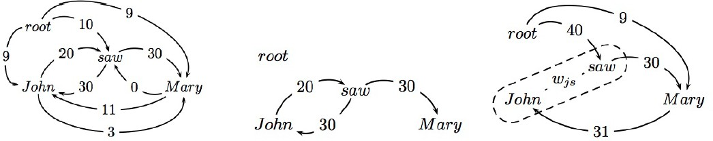
Chu-Liu-Edmonds Algorithm
Outgoing arc weights
Equal to the max of outgoing arc over all vertices in cycle e.g., John → Mary is 3 and saw → Mary is 30.
MST-based Dependency Parsing
Week 6, Lecture 4

Slide 48
Chu-Liu-Edmonds Algorithm
Incoming arc weights
Equal to the weight of best spanning tree that includes head of incoming arc and all nodes in cycle
root → saw → John is 40 root → John → saw is 29
MST-based Dependency Parsing
Week 6, Lecture 4

Slide 49
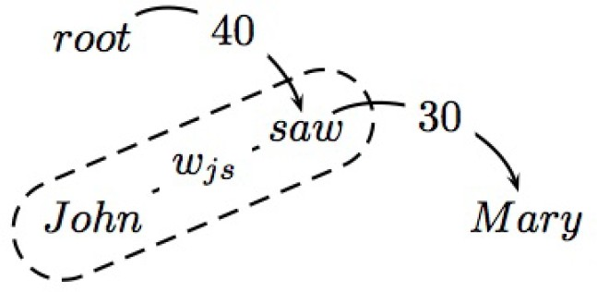
Chu-Liu-Edmonds Algorithm
Calling the algorithm again on the contracted graph:
This is a tree and the MST for the contracted graph
Go back up the recursive call and reconstruct final graph
MST-based Dependency Parsing
Week 6, Lecture 4

Slide 50
Chu-Liu-Edmonds Algorithm
The edge from w_{js} to Mary was from saw
The edge from root to w_{js} represented a tree from root to saw to John.
MST-based Dependency Parsing
Week 6, Lecture 4

Slide 51
MST-based Dependency Parsing: Learning
Pawan Goyal
CSE, IIT Kharagpur
Week 6, Lecture 5
MST-based Dependency Parsing: Learning
Week 6, Lecture 5
1 / 10

Slide 52
Arc weights as linear classifiers
w_{ij}^{k} = w.f (i, j, k)
Arc weights are a linear combination of features of the arc f (i, j, k) and a corresponding weight vector w
What arc features?
MST-based Dependency Parsing: Learning
Week 6, Lecture 5
2 / 10

Slide 53
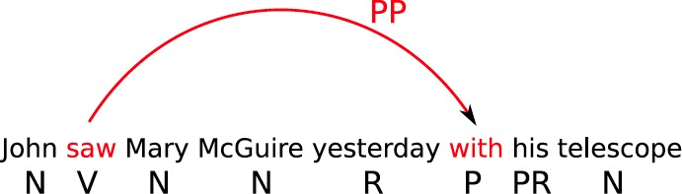
Arc Features f (i, j, k)
Features
Identities of the words w_{i} and w_{j} for a label l_{k}
head = saw & dependent=with
MST-based Dependency Parsing: Learning
Week 6, Lecture 5
3 / 10

Slide 54
Arc Features f (i, j, k)
Features
Part-of-speech tags of the words w_{i} and w_{j} for a label l_{k}
head-pos = Verb & dependent-pos=Preposition
MST-based Dependency Parsing: Learning
Week 6, Lecture 5
4 / 10

Slide 55
Arc Features f (i, j, k)
Features
Part-of-speech of words surrounding and between w_{i} and w_{j}
inbetween-pos = Noun inbetween-pos = Adverb dependent-pos-right = Pronoun head-pos-left=Noun
MST-based Dependency Parsing: Learning
Week 6, Lecture 5
5 / 10

Slide 56
Arc Features f (i, j, k)
Features
Number of words between w_{i} and w_{j}, and their orientation
arc-distance = 3 arc-direction = right
MST-based Dependency Parsing: Learning
Week 6, Lecture 5
6 / 10

Slide 57
Arc Features f (i, j, k)
Features
Combinations
head-pos=Verb & dependent-pos=Preposition & arc-label=PP head-pos=Verb & dependent=with & arc-distance=3
No limit : any feature over arc (i, j, k) or input x
MST-based Dependency Parsing: Learning
Week 6, Lecture 5
7 / 10

Slide 58
Learning the parameters
Re-write the inference problem
X
G = argmax
wij^{k}
^{G∈T(Gx )} (i,j,k)∈G
= argmax w · ^{X} f (i, j, k)
G∈T(Gx )
(i,j,k)∈G
= argmax w · f (G)
G∈T(Gx )
Which can be plugged into learning algorithms
MST-based Dependency Parsing: Learning
Week 6, Lecture 5
8 / 10

Slide 59
Inference-based Learning
Training data: T = {
(x , G )}
|T|
t=1
t t
1. w⁽⁰⁾ = 0; i = 0
2. for n : 1..N
3. for t : 1..|T|
4.
5.
6.
7. i = i + 1
8. return w^{i}
Let G^{j} = argmax_{G}j w^{(i)}.f (G^{j})
if G^{j} ≠ G_{t}
w^{(i+1)} = w^{(i)} + f (G_{t}) − f (G^{j})
MST-based Dependency Parsing: Learning
Week 6, Lecture 5

Slide 60
Example
Suppose you are training MST Parser for dependency and the sentence, “John saw Mary” occurs in the training set. Also, for simplicity, assume that there is only one dependency relation, “rel”. Thus, for every arc from word w_{i} to w_{j}, your features may be simplified to depend only on words w_{i} and w_{j} and not on the relation label.
Below is the set of features
f₁: pos(w_{i}) = Noun and pos(w_{j}) = Noun f₂: pos(w_{i}) = Verb and pos(w_{j}) = Noun f₃: w_{i} = Root and pos(w_{j}) = Verb
f₄: w_{i} = Root and pos(w_{j}) = Noun
f₅: w_{i} = Root and w_{j} occurs at the end of sentence
f₆: w_{i} occurs before w_{j} in the sentence
f₇: pos(w_{i}) = Noun and pos(w_{j}) = Verb
The feature weights before the start of the iteration are: {3, 20, 15, 12, 1, 10, 20}. Determine the weights after an iteration over this example.
MST-based Dependency Parsing: Learning
Week 6, Lecture 5

